Slide 1
Objectives
In this lesson, you will learn about:
  Role of XML in Java Platform
  Introducing Web Services Concept
  Web Services Standards
  APIs and Tools to Develop Java Web Services

Slide 2
Role of XML in Java Platform
  XML is the natural choice for developing enterprise level Web applications using Java because of its data portability and platform independence feature.
  Developers can implement the platform independent feature of the Java programming language to develop applications and exchange application data using XML.

Slide 3
Role of XML in Java Platform (Contd.)
  The features of XML and Java are:
    Platform independence
    Security
    Scalability
    Reliability

Slide 4
Role of XML in Java Platform (Contd.)
  The advantages of developing Web applications using XML are:
    Supports exchange of data between heterogeneous databases and systems.
    Distributes data processing load to the Web browser.
    Integrates Java servers with Web browsers.

Slide 5
Introducing Web Services Concepts
  Web services are applications that allow integration of applications developed in different languages that can run on different platforms.
  Features of Web services are:
    Interoperability
    Dynamic integration
    Industry standards
    Security

Slide 6
Introducing Web Services Concepts (Contd.)
  The various roles of the Web Services are:
    Service Provider: Provides software components that are published as Web services.
    Service Broker: Allows Web clients to search the registry for information about published Web services.
    Service Client: Locates the Web service in the service registry and invokes the services implemented by the Web service.

Slide 7
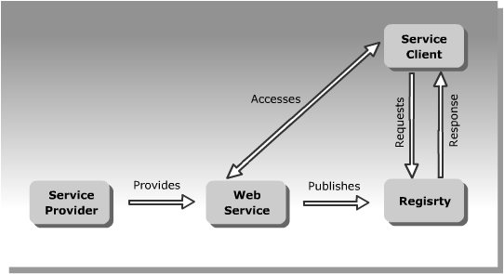
Introducing Web Services Concepts (Contd.)
  The following figure represents the Web services life cycle:

Slide 8
Introducing Web Services Concepts (Contd.)
  Stages in the life cycle of a Web service are:
    Developing a Web service
    Publishing a Web service
    Locating a Web service
    Accessing a Web service

Slide 9
Web Services Standards
  Web services are a set of specifications formulated and accepted by the leading enterprises that provide or avail Web services.
  Various Web services standards are:
    SOAP
    UDDI
    WSDL

Slide 10
Web Services Standards (Contd.)
  SOAP
    Is an XML-based standard protocol of Web services.
    Enables communication between Web services and Web service clients.
    Allows different enterprises to communicate and exchange information as SOAP messages.

Slide 11
Web Services Standards (Contd.)
  Features of SOAP protocol are:
    Programming is language-independent
    Platform-independent
    Object-oriented
    Does not require any technology at its endpoints

Slide 12
Web Services Standards (Contd.)
  Elements of a SOAP message are:
    SOAP Envelope element
    SOAP Header element
    SOAP Body element

Slide 13
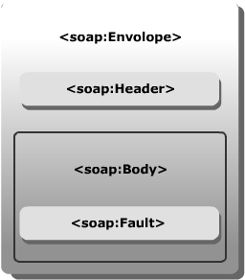
Web Services Standards (Contd.)
  The following figure represents the skeleton of a SOAP message:

Slide 14
Web Services Standards (Contd.)
  UDDI
    Is a standard to publish Web services.
    Provides a set of APIs that service providers can use to publish or locate services in registries.
    Enables business integration in service oriented architecture using industry standards, such as XML, HTML, and SOAP.

Slide 15
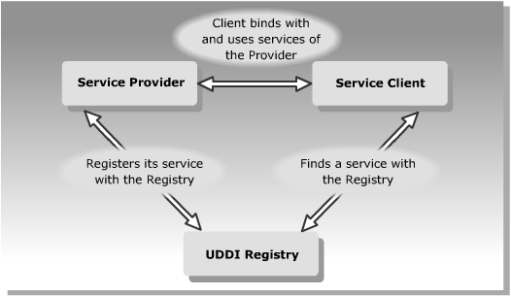
Web Services Standards (Contd.)
  The following figure represents the role of UDDI registry in a Web service:

Slide 16
Web Services Standards (Contd.)
  WSDL
    Is a standard, XML-based language.
    Defines how Web services are described when they are published in a registry.
    Web services information is published in the registries as WSDL documents.

Slide 17
Web Services Standards (Contd.)
  Some of the elements of a WSDL document are:
    types: Defines different custom data types that the Web service supports.
    message: Defines the message structure that needs to be implemented to communicate with the Web service.
    portType: Defines one or more operations provided by the Web service.
    binding: Defines the message format and protocol specifications for a particular port type, such as SOAP.
    service: Defines a set of ports that represents the end point of the Web service.

Slide 18
APIs and Tools to Develop Java Web Services
  The various Java Web Service APIs are:
    Java API for XML Processing (JAXP)
    Java API for XML Registries (JAXR)
    Java API for XML-based Remote Procedure Calls (JAX-RPC)
    SOAP with Attachment API for Java (SAAJ)
    Java API for XML Binding (JAXB)

Slide 19
APIs and Tools to Develop Java Web Services (Contd.)
  The various components of Java Web Services Developer Pack (JWSDP) are:
    XML and Web Services Security
    Java Server Faces (JSF) 1.0
    Java API for XML Binding (JAXB) 1.0.2
    Java API for XML Processing (JAXP) 1.2.4
    Java API for XML Registries (JAXR) 1.0.5
    Java API for XML-based Remote Procedure Calls (JAX-RPC) 1.1

Slide 20
APIs and Tools to Develop Java Web Services (Contd.)
  Java Web Services Developer Pack (JWSDP) (Contd.)
    SOAP with Attachment API for Java (SAAJ) 1.2
    JavaServer Pages Standard Tag Library (JSTL) 1.1
    Java WSDP Registry Server 1.0_06
    Tomcat (Java Servlet and Java Server Pages Container)
    Ant Build tool
    Web Services-Interoperability (WS-I) Sample Application

Slide 21
Summary
  In this lesson, you learned that:
  XML plays an important role in enterprise integration of data using Java.
  XML supports platform independent data and Java supports platform independent processing of data.
  XML offers integration of data to share data among different departments in an enterprise and also communicate and share data between various enterprises.
  The various features that are provided by XML are:
    Security
    Portability
    Scalability
    Reliability

Slide 22
Summary (Contd.)
  Web services provide a means of communication between various software applications that run on different platforms.
  A Web service is identified using a URL that is accessed by the clients using XML-based protocols over an Internet protocol.
  Web services are based on the service-based architecture that implements well-defined business logic and represents this business logic through given standards and interfaces.
  The architecture of a Web service consists of the following entities:
    Service Provider
    Service Broker
    Service Client

Slide 23
Summary (Contd.)
  The life cycle of a Web service consists of the following stages:
    Develop
    Publish
    Discover
    Access
  The various Web services standards are:
    SOAP
    UDDI
    WSDL

Slide 24
Summary (Contd.)
  The various schemes used for security of XML and Web services are:
    XML Encryption
    XML Digital Signature
    SAML
    XCAML
    Web service security model

Slide 25
Summary (Contd.)
  The various components of JWSDP are:
    JSF
    JAXB
    JAXP
    JAXR
    JAX-RPC
    SAAJ
    JSTL
    JWSDP Registry Server

